Slide 1
The Queen’s College
IT Open Morning
Microsoft Network Policy Server + VLANs/ACLs

Slide 2
What does it do?
Network Policy Server
  Authenticates devices based on
    802.1x Credentials
      Username/Password
      Certificate
    MAC Address
  Places the client in the correct VLAN + send other RADIUS Attributes

Slide 3
Alternatives…
Bradford Network Sentry
Aruba Clear Pass
PacketFence

Slide 4
Network Switch Config
aaa port-access gvrp-vlans
aaa authentication port-access eap-radius
aaa port-access authenticator 1-8
aaa port-access authenticator 1-8 quiet-period 30
aaa port-access authenticator 1-8 tx-period 2
aaa port-access authenticator 1-8 supplicant-timeout 2
aaa port-access authenticator 1-8 server-timeout 10
aaa port-access authenticator 1-8 max-requests 3
aaa port-access authenticator 1-8 reauth-period 600
aaa port-access authenticator 1-8 auth-vid 1
aaa port-access authenticator 1-8 client-limit 3
aaa port-access authenticator active
aaa port-access mac-based 1-8
aaa port-access mac-based 1-8 logoff-period 862400
aaa port-access mac-based 1-8 quiet-period 30
aaa port-access mac-based 1-8 server-timeout 10
aaa port-access mac-based 1-8 reauth-period 600
aaa port-access mac-based 1-8 unauth-vid 97
aaa port-access mac-based 1-8 addr-limit 3
aaa port-access 1-8 controlled-direction in
radius-server host 172.16.0.2 key <key!!>
radius-server dead-time 1
radius-server timeout 3
radius-server retransmit 2
aaa authentication login privilege-mode
aaa authentication ssh login radius local
aaa authentication ssh enable radius local
aaa port-access mac-based addr-format no-delimiter

Slide 5
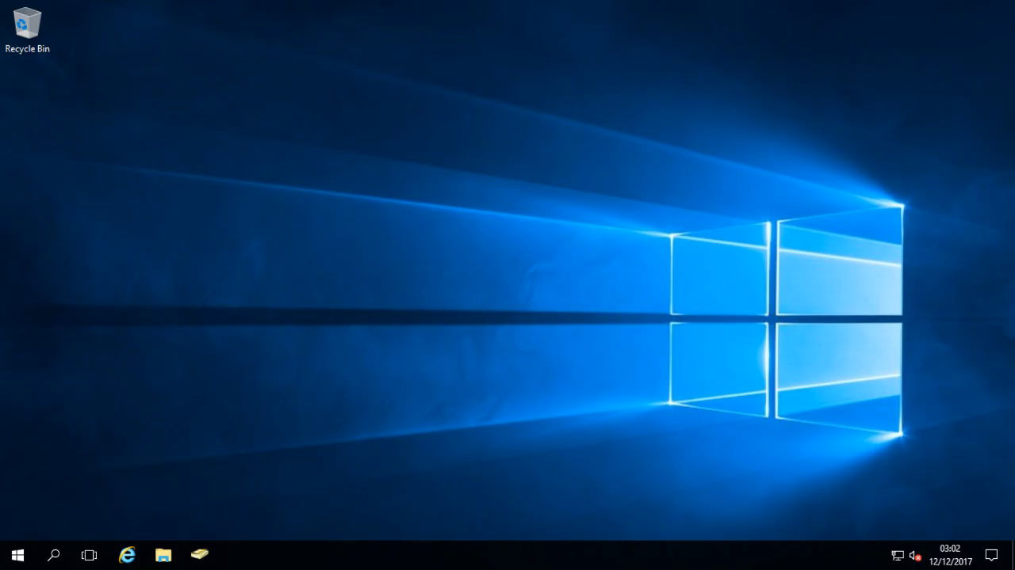
Notes:
Install AD CA
Configure computer Cert

Slide 6
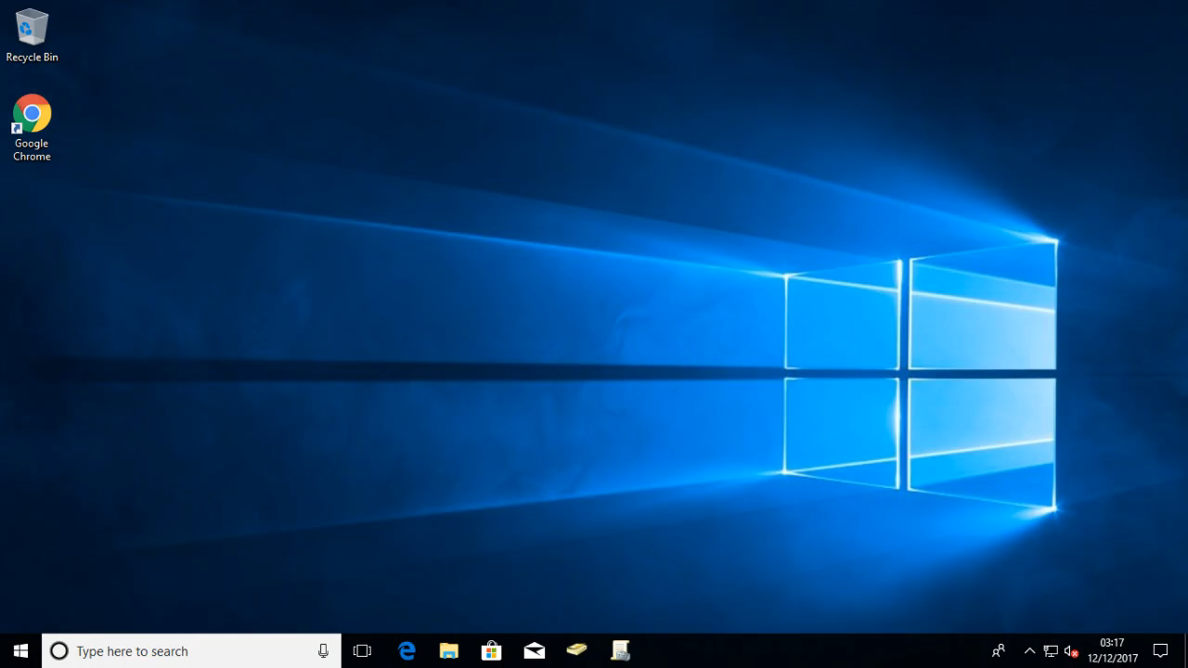
Notes:
Configure computer cert
Enable computer cert

Slide 7
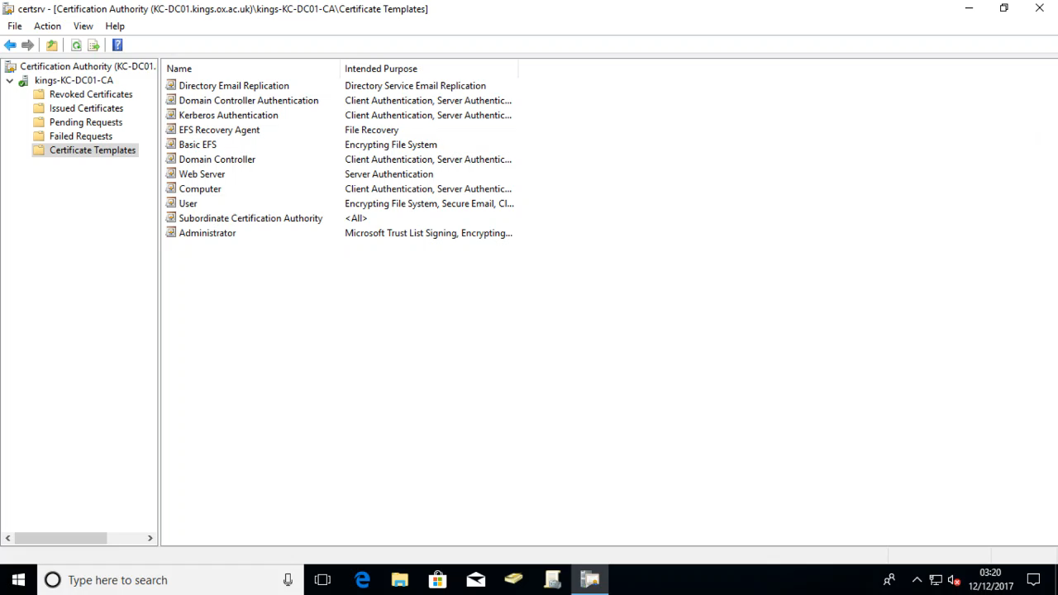
Notes:
Enable computer cert

Slide 8


Slide 9
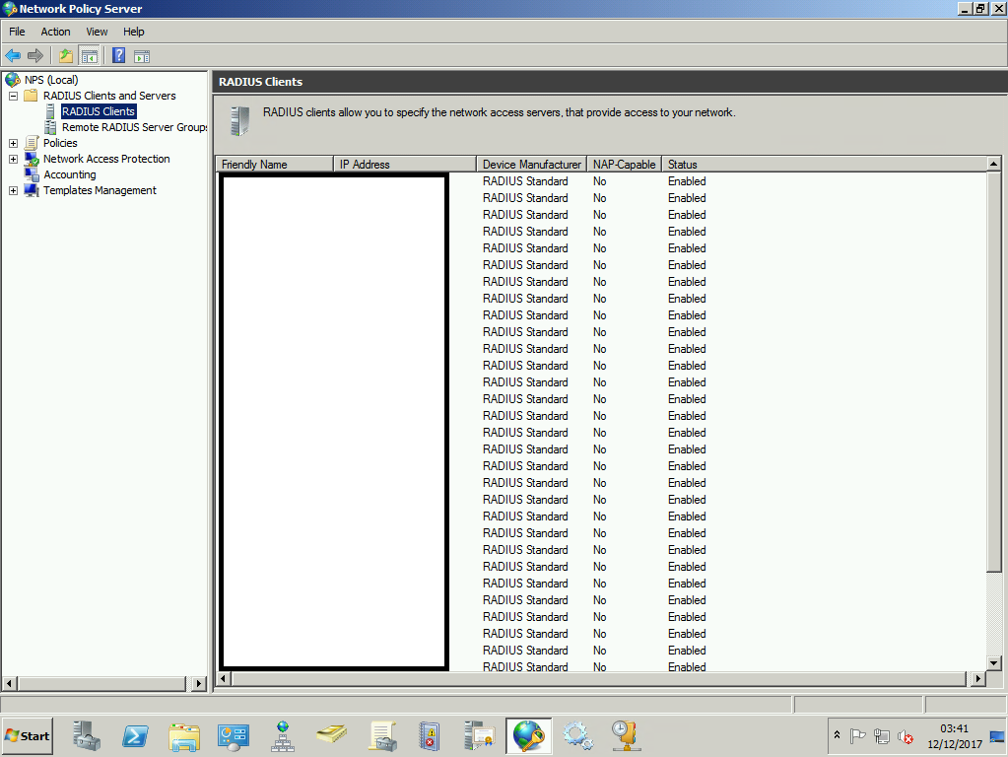

Slide 10
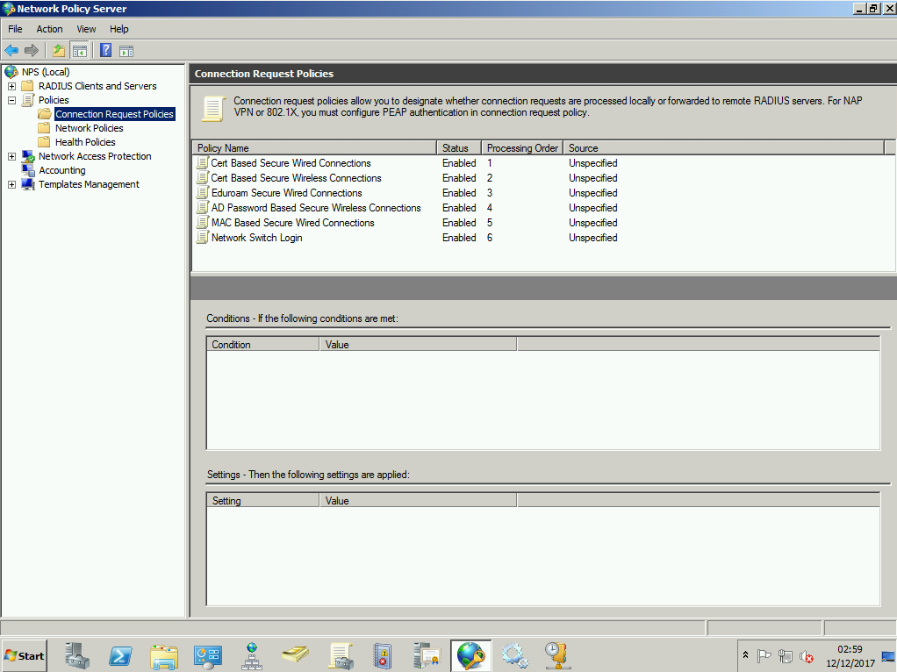

Slide 11
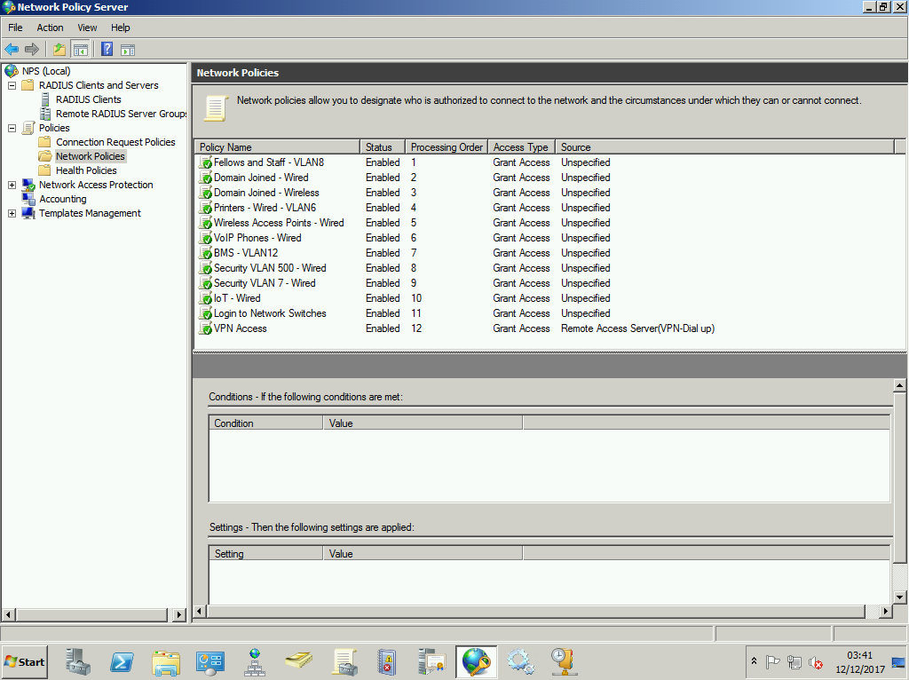

Slide 12
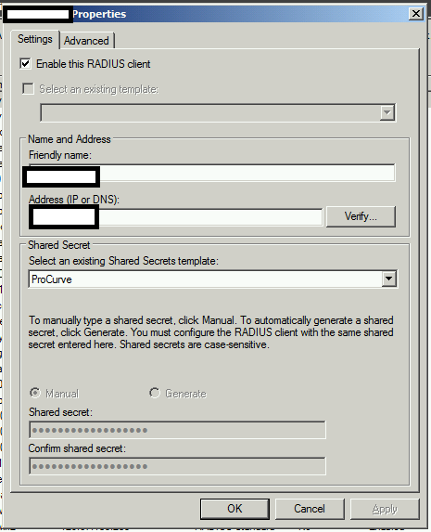

Slide 13
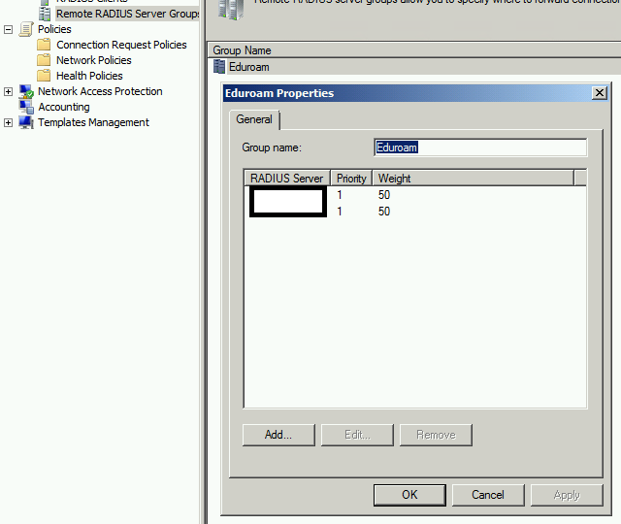

Slide 14
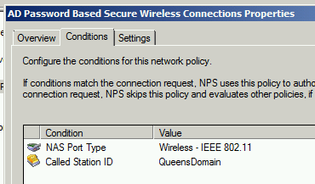
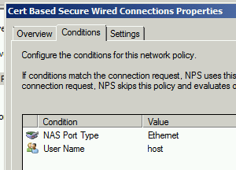
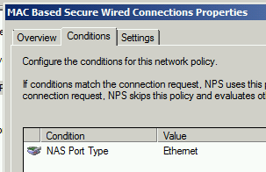
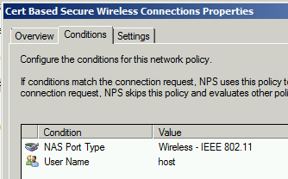

Slide 15
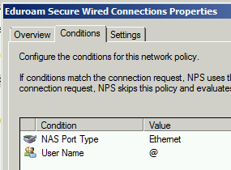
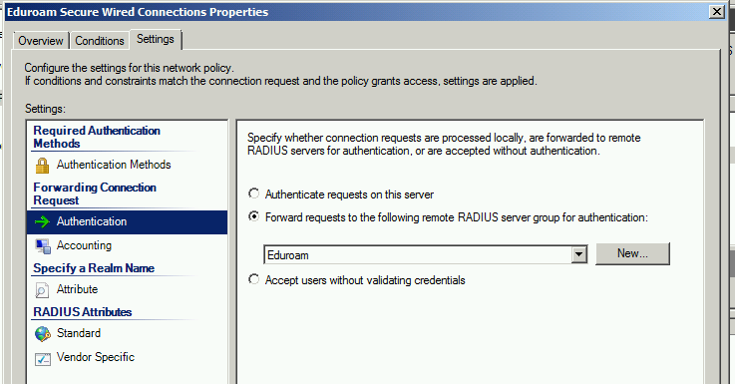
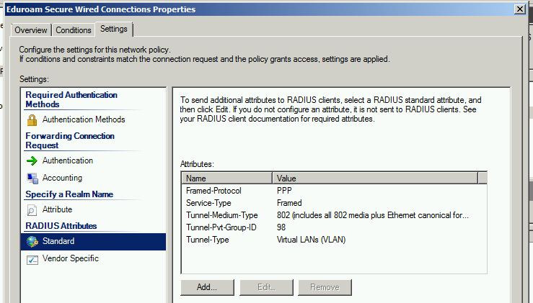

Slide 16
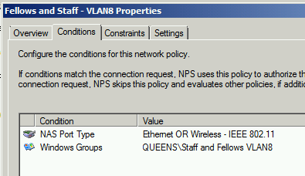
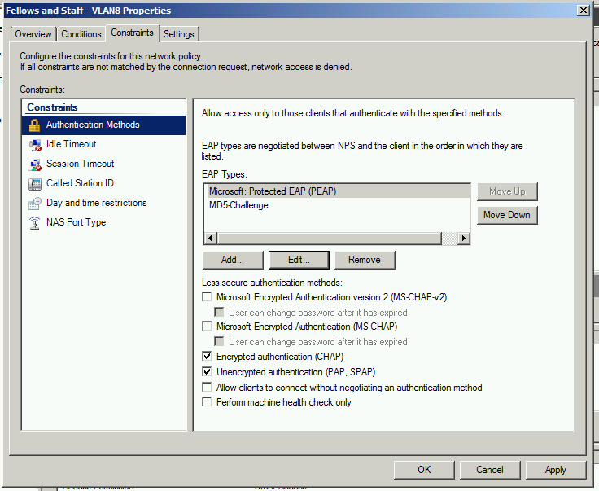
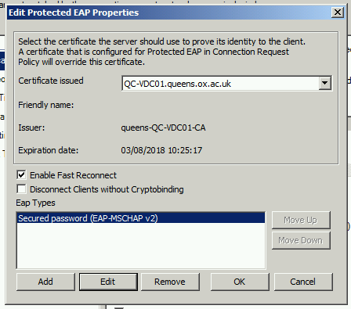

Slide 17
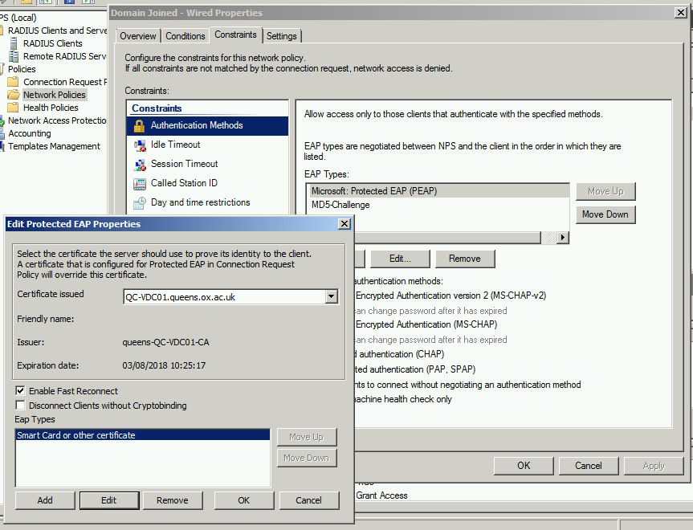

Slide 18
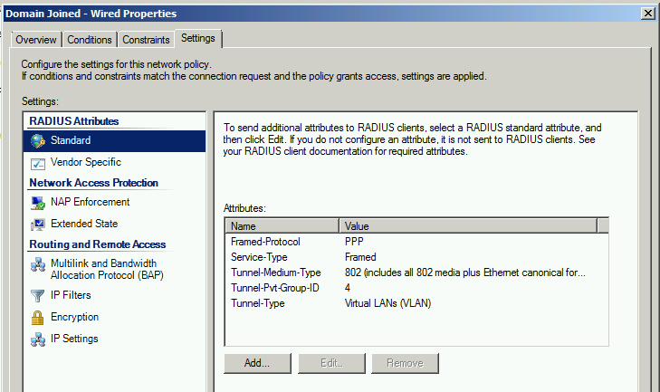

Slide 19
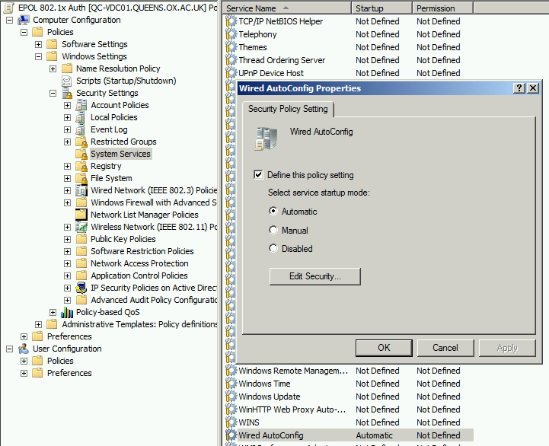

Slide 20
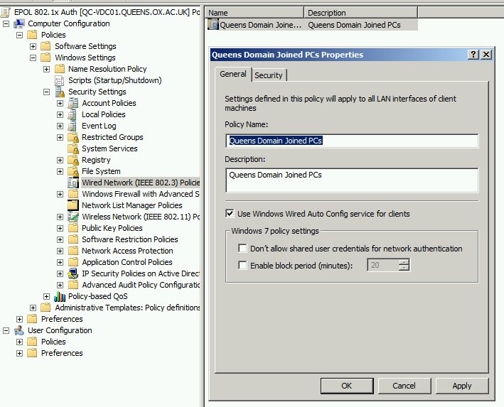

Slide 21
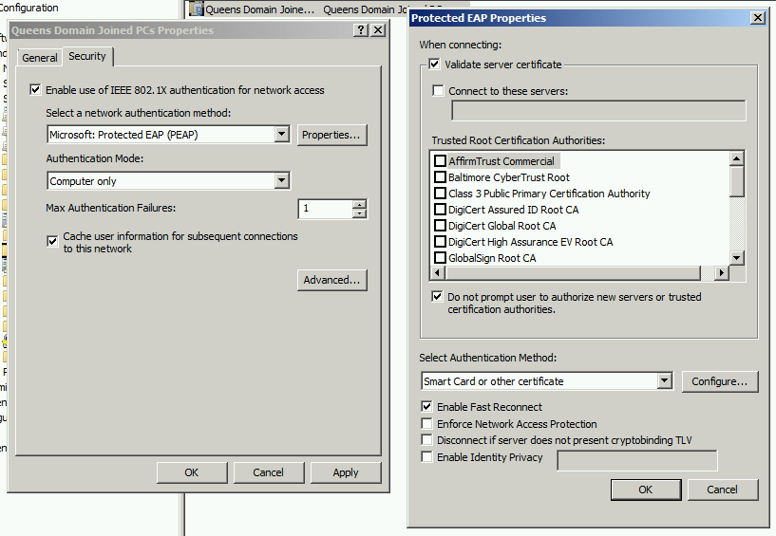

Slide 22
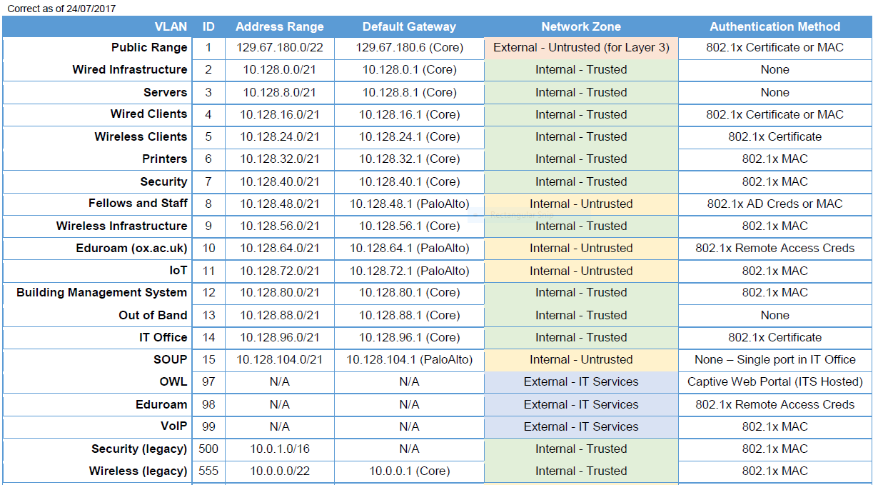

Slide 23
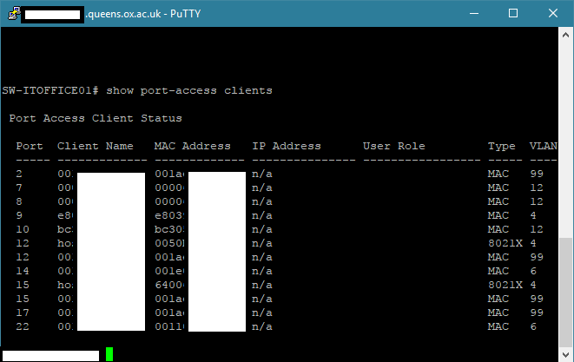

Slide 24
ACLS Slide

Slide 25
Further Reading
Lynda.com https://www.lynda.com/Windows-Server-tutorials/Overview-Network-Policy-Server-NPS/459490/505660-4.html

