Slide 1
The Queen’s College
IT Open Morning

Slide 2
Goals
Get a overview of some of the tools we use
Find out where to go to get more information
Installations
Operations
Lynda.com
myworldofit.net
Other resources

Slide 3
The Plan
Start time
0910 | Welcome, Microsoft Deployment Toolkit
0940 | PowerShell
1010 | PRTG Network Monitor
1030 | Break for Tea/Coffee
1100 | OpenVAS
1130 | Windows Server Update Services + Chocolatey
1200 | Microsoft Network Policy Server + VLANs/ACLs
1230 | End

Slide 4
The IT Office
3 Full Time Staff
3 Hyper-V Hosts
Largely Microsoft for Services

Slide 5
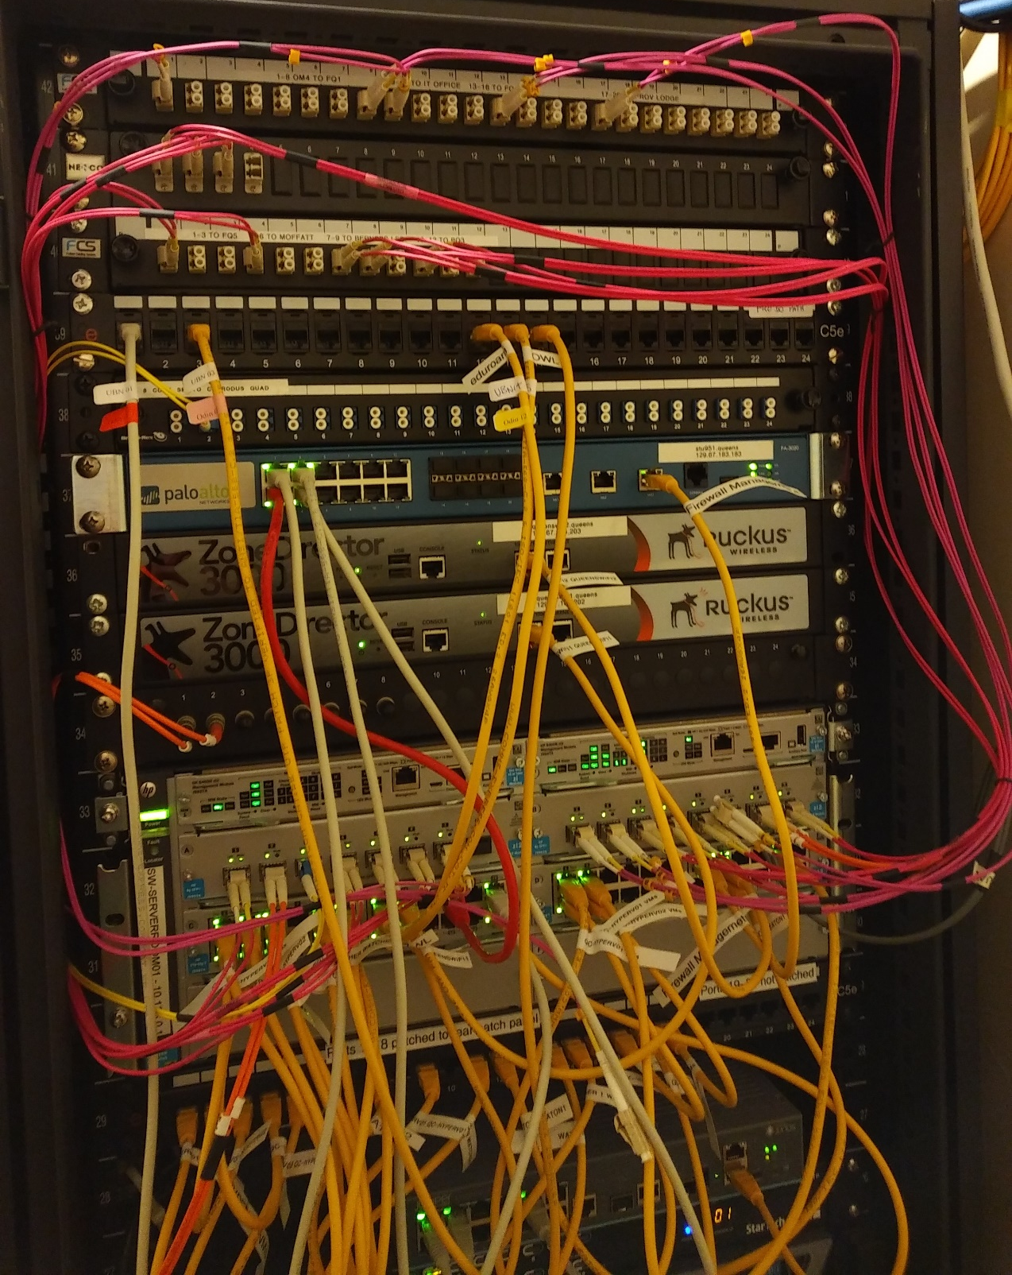
PaloAlto Firewall
Rucuks Wireless ZD3000 + 7363
HPE 5400R zl2 Core Switch + 2530s and 2920s at the edge
Juniper DMZ switch (for now)

Slide 6
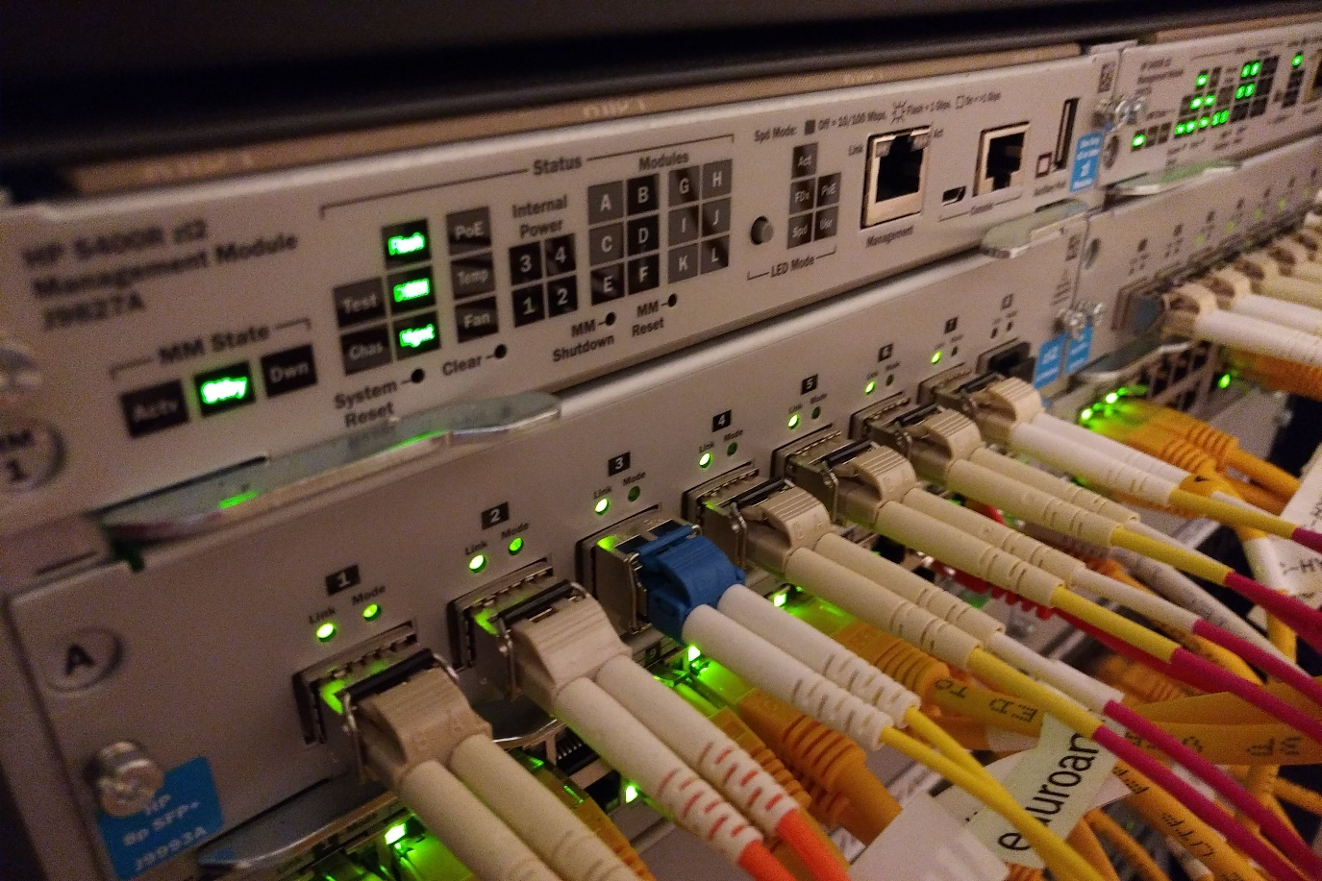
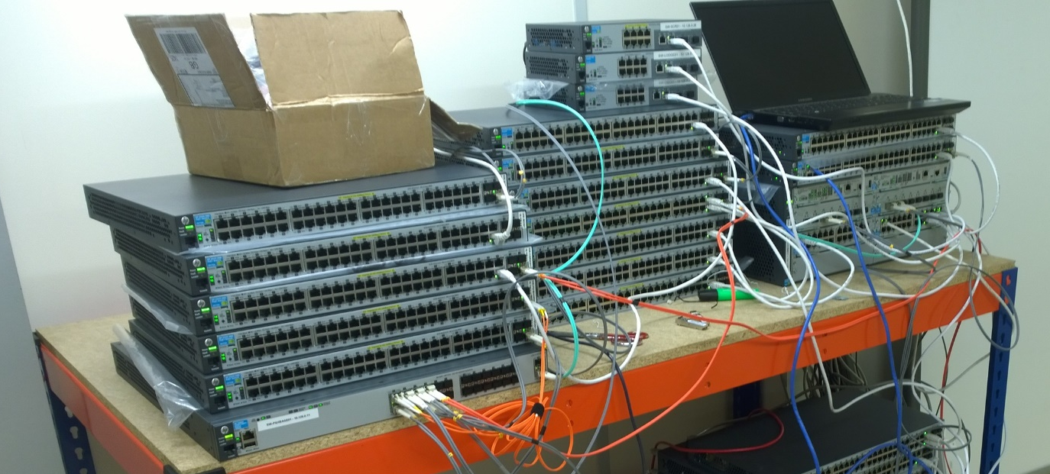

Slide 7
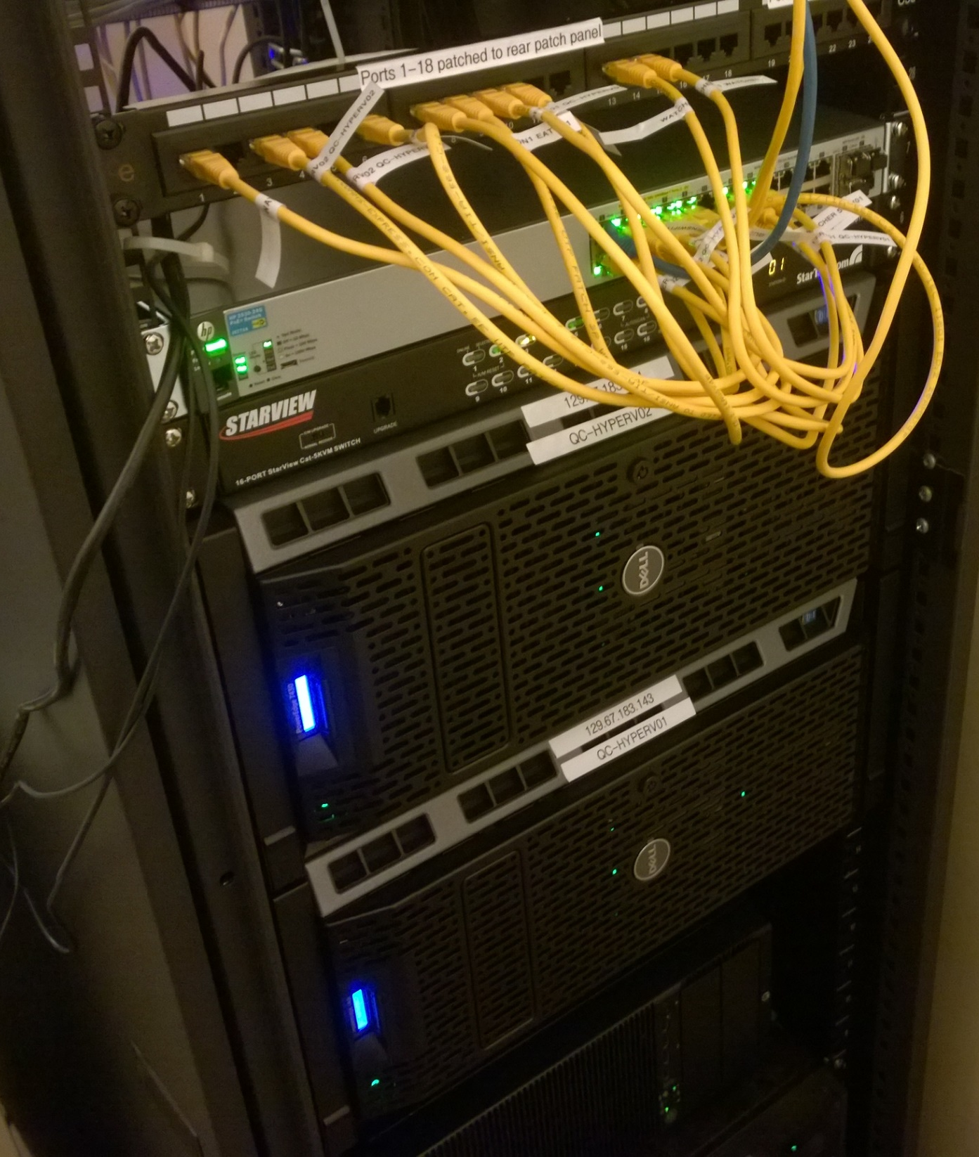
2x Dell T430s in Server Room
1x Dell T430 in DR Room

Slide 8
Hyper-V Server
Free for the whole feature set
  Unlimited VMs
  Supports Windows and Linux/FreeBSD
  5 Minute Replication
  Discrete device assignment (DDA)
  Secure Boot
  Clustering
  Live Migration
https://docs.microsoft.com/en-gb/windows-server/virtualization/hyper-v/hyper-v-technology-overview
https://www.microsoft.com/en-us/evalcenter/evaluate-hyper-v-server-2016

Slide 9

Our implementation of Hyper-V
Every 5 minutes everything is replicated to the DR Host
DR Host
Local Storage
Dell T430 Tower Servers (with Rail Kits)
48GB RAM/host
Primary Hosts

Slide 10
Server 2008 R2 to Server 2016
Moved from Select Agreement (Perpetual) to Microsoft Enrolment For Education Solutions
Price fixed for 3 years
Super low cost – Select Agreement would need to run for at least 7 years to be as cost effective
Contact oxforduni@bytes.co.uk to arrange

Slide 11
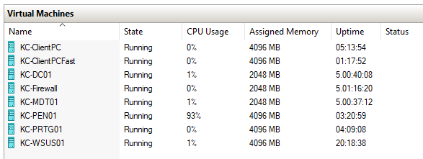
The King’s College, Oxford

